Slide 1

STATION 1: Crushed by You!
MATERIALS:
2 Alka Seltzer tablets
2 Cups of water
2 stop watches
DIRECTIONS:
1. Fill up each cup with tap water.
2. Open the alka seltzer package.
3. Take one tablet out and put it aside.
4. Leave one tablet in the package and using a pen/hand, crush the tablet in the package.
5. Clear the stop watches, dump the solid tablet into 1 cup and dump the crushed tablet into the other cup.
6. Begin timing each cup and stop the timer once the tablet has completely dissolved.
7. Record the data.
8. Dump out the cups.
9. Answer the questions.

Slide 2
STATION 1:
Crushed by You!

Slide 3
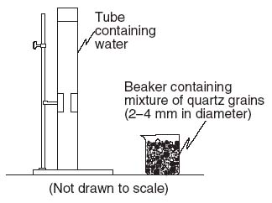
STATION 2: Drop that Sediment!
STATION 2: Drop that Sediment!
MATERIALS:
2 Vertical tubes full of water
2 trays: large & small sediments
2 stop watches(You may use cell phones)
DIRECTIONS:
1. Assign each partner a column and a stop watch.
2. For each column, you will only use 1 size bead.
3. One at a time, you will drop a bead into the cylinder and
time its descent from the top tape line until the bottom type line.
4. Record the time it took the sediment to fall.
5. Do this for each bead size 3 times.
6. Find the average of each bead size’s settling time.
7. Answer the questions.

Slide 4
STATION 2:
Drop that Sediment!

Slide 5

STATION 3:
Observation/Inference A

Slide 6
STATION 3: Observation/
Inference A
MATERIALS:
3 weathering images
DIRECTIONS:
1. Using each photograph, answer the questions that correspond to each photograph.
2. Once you are done with the photograph, please put it back on the desk.

Slide 7
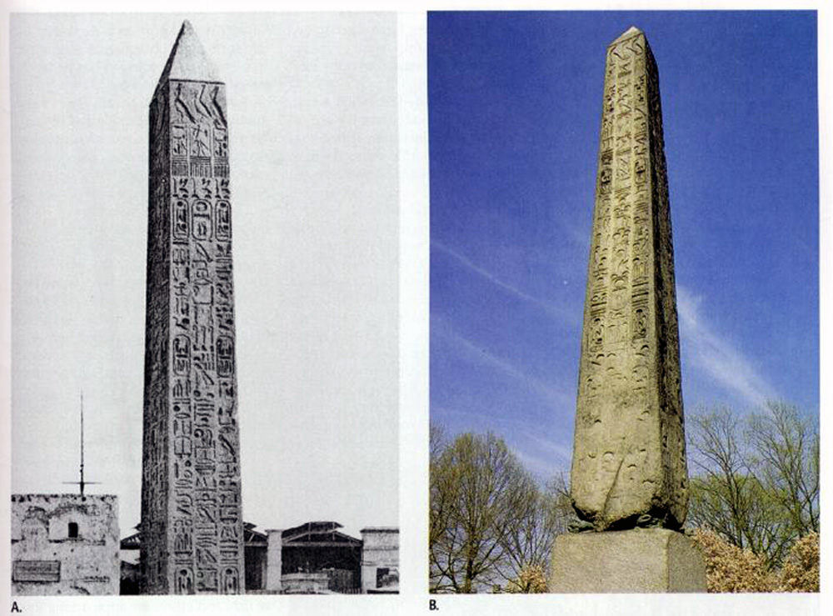
PHOTO #1
A
B

Slide 8
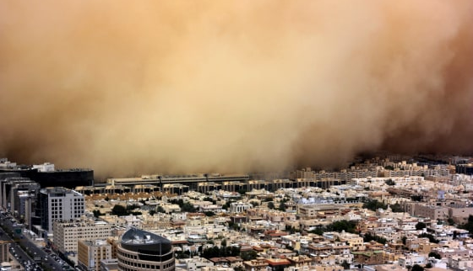
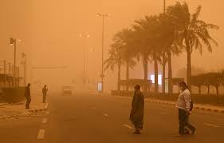
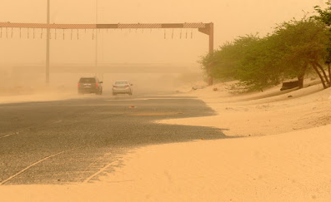
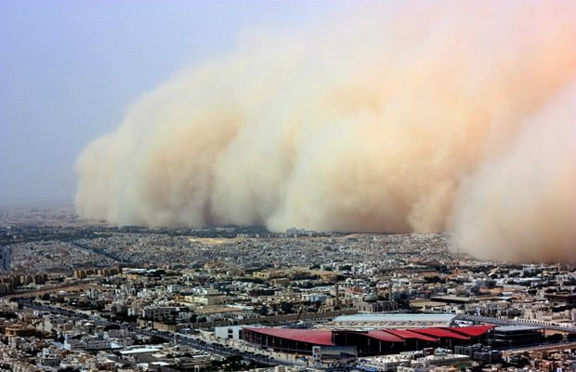
PHOTO COLLAGE #2 Location: Kuwait

Slide 9
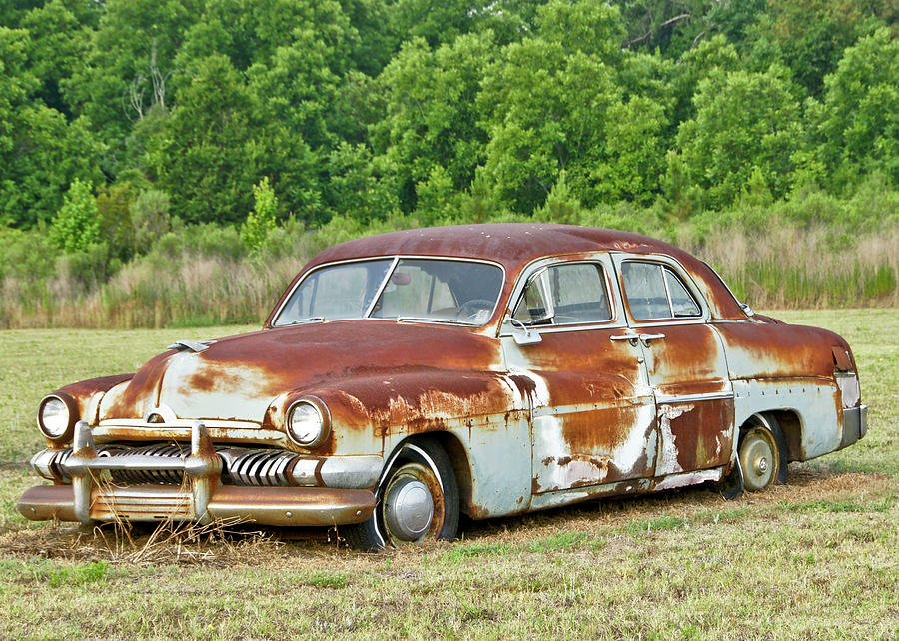
PHOTO #3

Slide 10
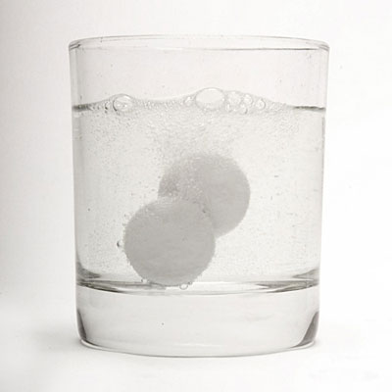
STATION 4:
Weathering or Not?

Slide 11
STATION 4: Weathering or Not?
MATERIALS:
2 Alka Seltzer tablets
2 Cups
2 stop watches
1 hot pot of water (be careful)
1 cup of room temperature water
DIRECTIONS:
Fill up each labeled cup. One with tap water, the other with hot water
(be careful)
2. Open the alka seltzer package.
3. Take both tablets out whole.
4. Drop 1 tablet in the room temperature cup and start timing.
5. Drop the second tablet in the hot cup and start timing.
6. Stop timing each cup once its tablet has fully dissolved.
7. Record the data.
8. Dump out the cups.
9. Answer the questions.

Slide 12
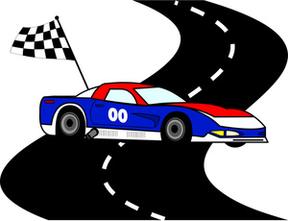
STATION 5:
The Race is On!

Slide 13
STATION 5:
The Race is On!
MATERIALS:
4 wooden cars
2 different sloped ramps
2 stop watches
DIRECTIONS:
1. Assign each partner a ramp and a stop watch.
2. Record the time it took the car to travel from the bottom of the ramp until the “finish line”.
3. Do this for each ramp 3 times.
4. Find the average of each ramp’s race time.
5. Answer the questions.

Slide 14
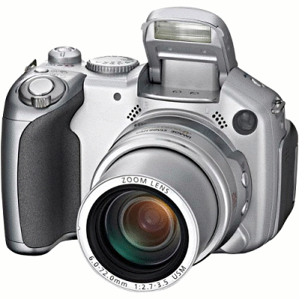
STATION 6:
Observation/Inference B

Slide 15
STATION 6:
Observation/
Inference B
MATERIALS:
3 weathering images
DIRECTIONS:
1. Using each photograph, answer the questions that correspond to each photograph.
2. Once you are done with the photograph, please put it back on the desk.

Slide 16
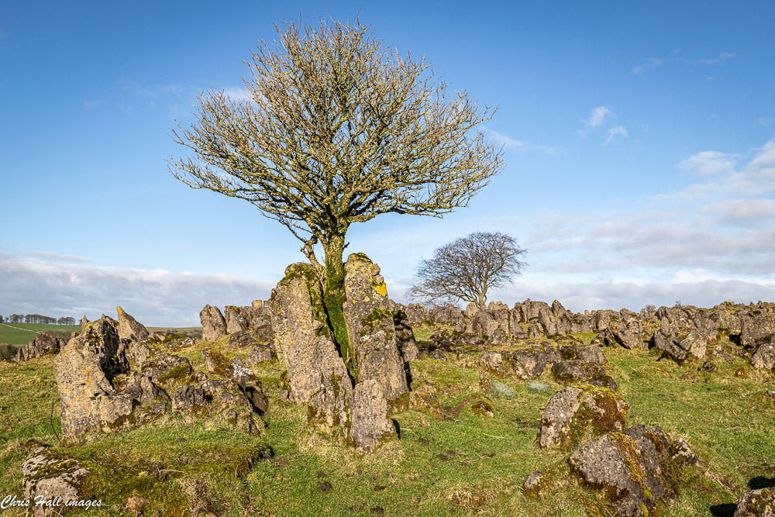
PHOTO #4

Slide 17
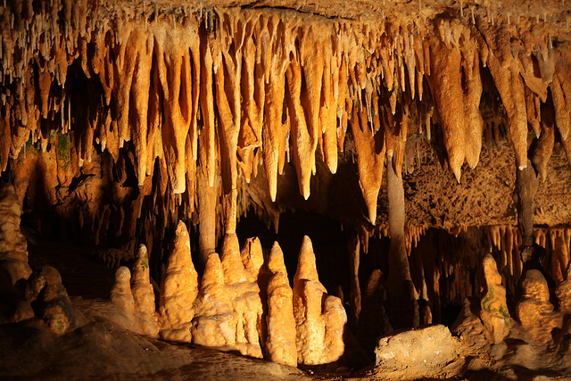
PHOTO #5
1
2

Slide 18
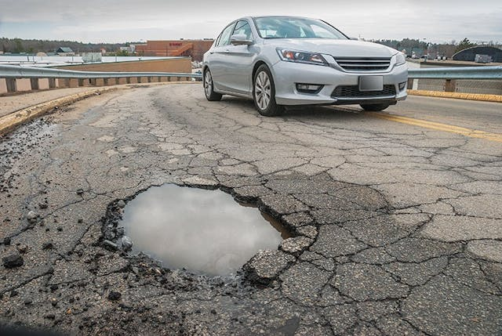
PHOTO #6

Slide 19
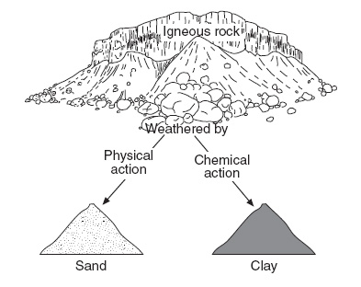
STATION 7:
Vocabulary/
Relationships
MATERIALS:
Textbooks/review books
DIRECTIONS:
1. Using your notes and books, define the vocabulary words.
2. Using your knowledge regarding weathering, draw and label
each relationship trend.

Slide 20
STATION 7:
Vocabulary/Relationships

Slide 21
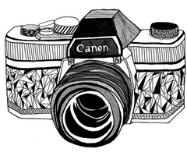
STATION 8:
Observation/Inference C

Slide 22
STATION 8: Observation/
Inference C
MATERIALS:
3 weathering images
DIRECTIONS:
1. Using each photograph, answer the questions that correspond to each photograph.
2. Once you are done with the photograph, please put it back on the desk.

Slide 23

STATION 8:
Observation/Inference C

Slide 24
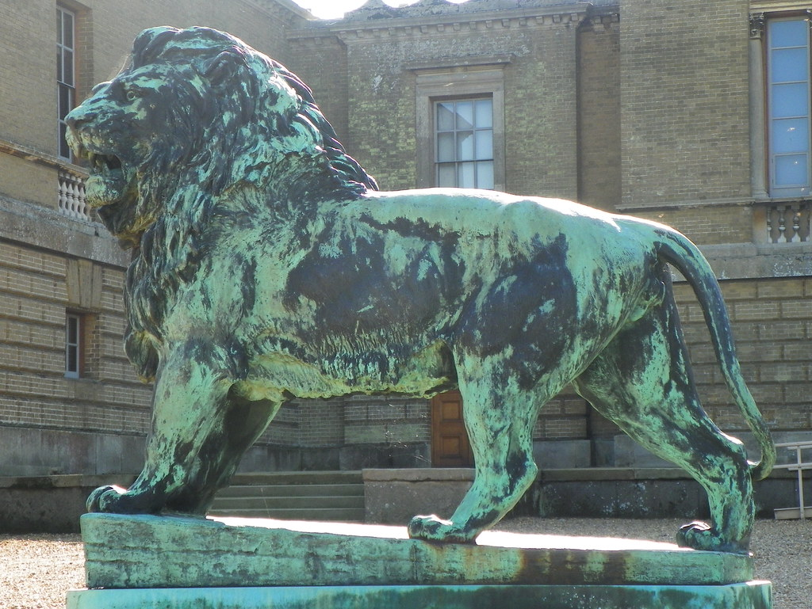
PHOTO #7

Slide 25
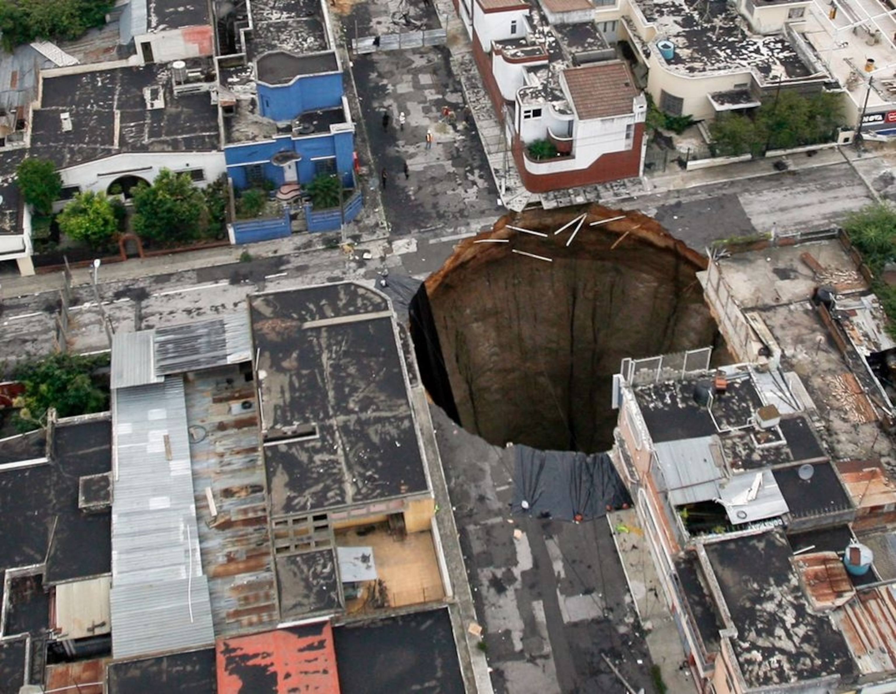
PHOTO #8 Guatemala

Slide 26
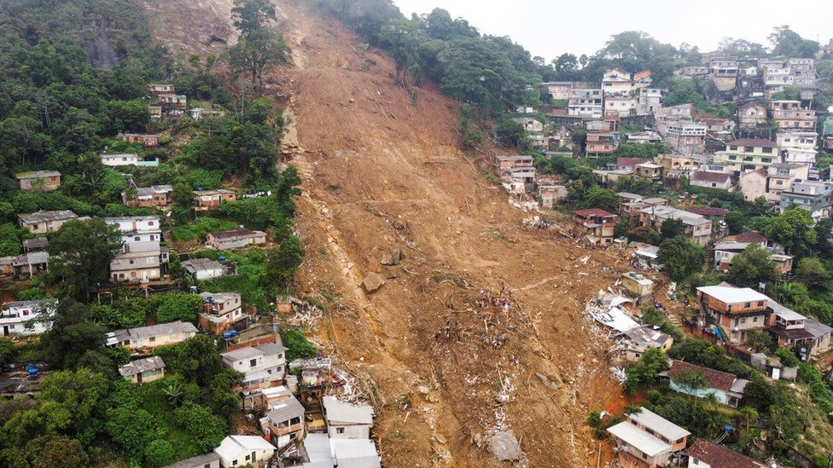
PHOTO #9 Brazil

